Slide 1
Comprehensive Digital Marketing
Project Work
Team details
Team lead – M. KAVYA SREE
Team members – D. SANJAY,
M. LEELA KUMARI,
AMAR BHARGAV,
CHETAN BHAIR.

Slide 2

Part 1: Brand study, Competitor Analysis & Buyer’s/Audience’s Persona.
Company / Topic for project: SUNFEAST
Research Brand Identity:
Brand logo:
Brand colours : Orange, Red, Yellow.
Brand tagline : “SPREAD THE SMILES”.
Brand’s website : https://www.sunfeastworld.com/

Slide 3
SUNFEAST’S MISSION / VALUES : To enhance the wealth generating capability of the enterprise in a globalised environment, delivering superior and sustainable stakeholder value.
SUNFEAST’S USP: Sunfeast offers a wide range of products, unique taste and nutrition in every bite and their unique style of packaging make them stand No.1 in the market.

Slide 4
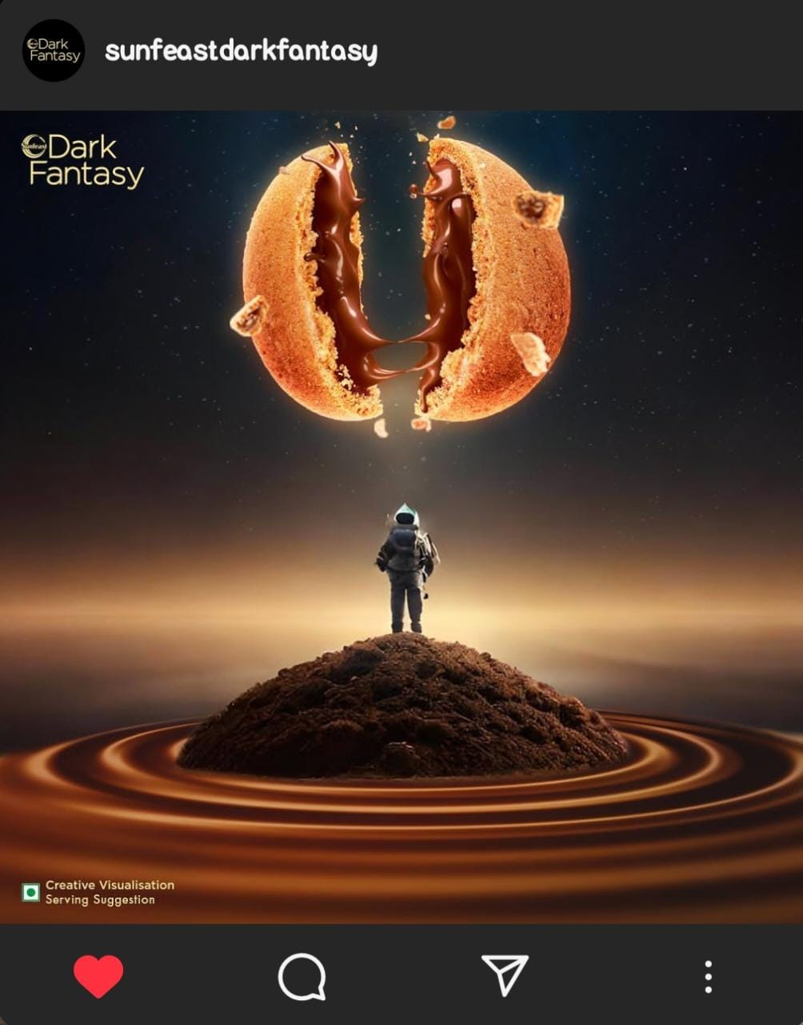
Analyze Brand Messaging: Sunfeast follows a brand messaging that revolves around the concepts of "Quality, Deliciousness, and Health." The brand focuses on creating delicious and high-quality food products that also cater to the health-conscious consumer. Sunfeast emphasizes the use of natural ingredients, nutritional benefits, and innovative flavors in their products. The elements that sunfeast follow while it’s brand message are quality, taste sensation, health consciousness, trust and reliability. To sum up sunfeast’s brand messaging highlights the combination of taste, quality and health, appealing to the customers who seek a holistic experience.
Brand’s online communication: Sunfeast dark fantasy’s instagram post after
the chandrayaan 3 launch. This shows that sunfeast’s online communication is fun, realistic,
engaging and aligned with the current affairs and updates.
Examine the brand's tagline: Sunfeast’s tagline – “SPREAD THE SMILES”
resembles the brand’s intention to create happiness for their customers through every
product they produce. This tagline conveys a positive and joyful message combining with the brand’s positioning as a producer of delicious snacks. The brand believes that, spreading smiles will come back in way that no one can imagine. The tag line itself says that the quality and hygiene they follow while producing a product to create a sort of trust among customers.

Slide 5


Competitor Analysis:
Competitor 1: PARLE
- https://www.parleproducts.com/
- USP : India’s most trusted top of the mind brand.
- TYPE OF COMMUNICATION : Relatable, up-to-date content, creative and occasion related.
Competitor 2: BRITANNIA
- https://www.britannia.co.in/
- USP : India’s very own baker and dairy products brand that is trusted for its quality.
- TYPE OF COMMUNICATION : Creative, engaging and attractive content.

Slide 6

Competitor 3 :
- https://www.unibicfoods.com/
- USP : Premium quality, nutritious and rich feel of fiber.
- TYPE OF COMMUNICATION : Engaging, creative and informative.

Slide 7
Buyer's/Audience's Persona:
DEMOGRAPHIC PERSONA :
AGE RANGE : Every one who loves to eat biscuits.
GENDER : Everyone.
MARITAL STATUS : Everyone.
LOCATION : India.
INCOME : Low, medium, high.
PSYCHOGRAPHIC PERSONA :
- Are you connected with the right individual ?
Yes, we are connected with the right people by their past purchase history and with the help of our social media handles by their search history.
- what social media channels our customer are using ?
As the world is becoming fully digital, each and everyone is having all social media accounts to socialize and follow updates in the world. ( Instagram, facebook, twitter, youtube, threads, etc...).

Slide 8
- What social media channel do they use the most ?
Most of our targeted customers are consuming most of their time in Instagram and Facebook. So marketing in these platforms makes us reach more customers.
- How do they get the information about our products ?
Customers get the information about our products through television ads and social media ads.
- What is important to them when considering our products ?
Now-a-days every one is becoming fitness freaks, so most of them will check health benefits in every thing they consume. And the other aspects maybe quality, taste and price.
- What objections someone might have while buying ?
Most of the people will price before buying. The other one would be quality of the product.

Slide 9
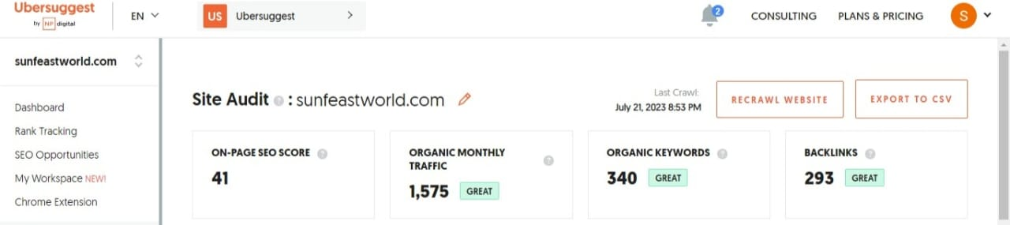
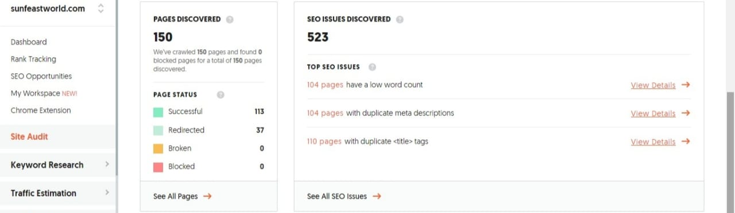
Part 2: SEO & Keyword Research
SEO Audit:

Slide 10
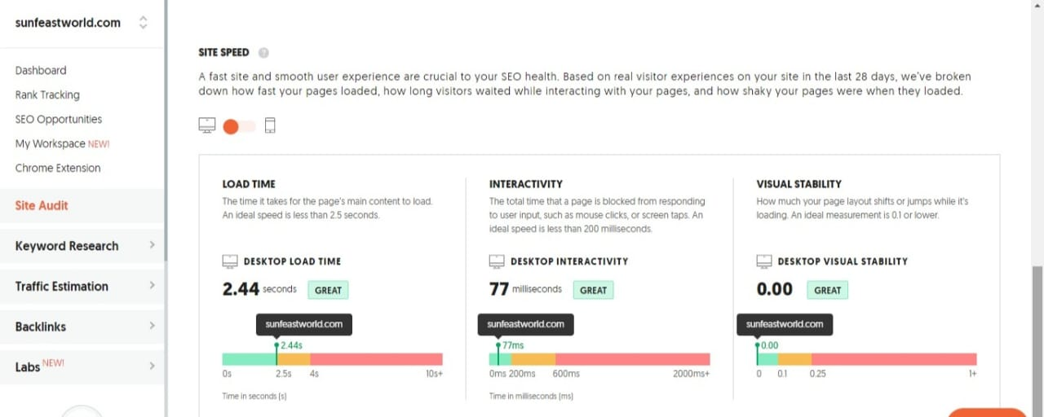

Slide 11
KEYWORD RESEARCH :
OBJECTIVES FOR KEYWORD RESEARCH:
TO INCREASE WEBSITE TRAFFIC:
As keyword research helps us know which key words are used by target customer mostly, by this we can improve our website traffic.
TO IMPROVE ORGANIC SEARCH RANKING:
By keyword research we can know which key words are performing best, which high search volume and lower competition, so that we can optimize our website with those key words to improve organic search ranking.
TO REACH OUT MORE AUDIENCE:
Keyword research helps us find out which keys are god to target out prospective customers and so that we can use those keywords in our website’s content.

Slide 12
SEED KEYWORDS:
sunfeast biscuits.
Sunfeast cookies.
Sunfeast snacks.
Sunfeast products.
Sunfeast brand.
Sunfeast farmalite.
Sunfeast cakes.
Sunfeast dark fantasy.
LONG TAIL KEYWORDS:
Healthy and nutritious sunfeast biscuits.
Vegan friendly sunfeast biscuits.
Low sugar and high fiber sunfeast biscuits.
New flavoured biscuits in sunfeast.
Sunfeast nutritious and digestive biscuits.
Sunfeast glucose biscuits with low sugar and calories.

Slide 13
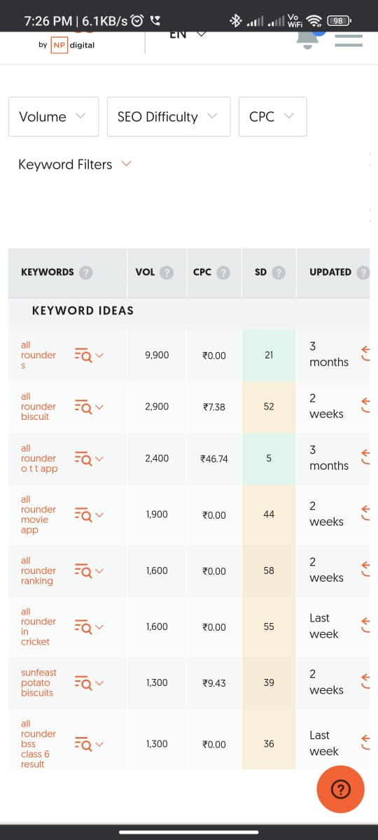
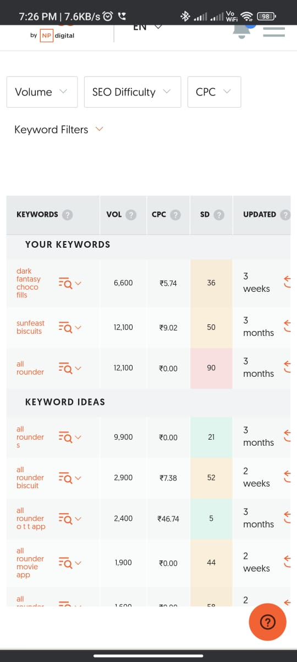
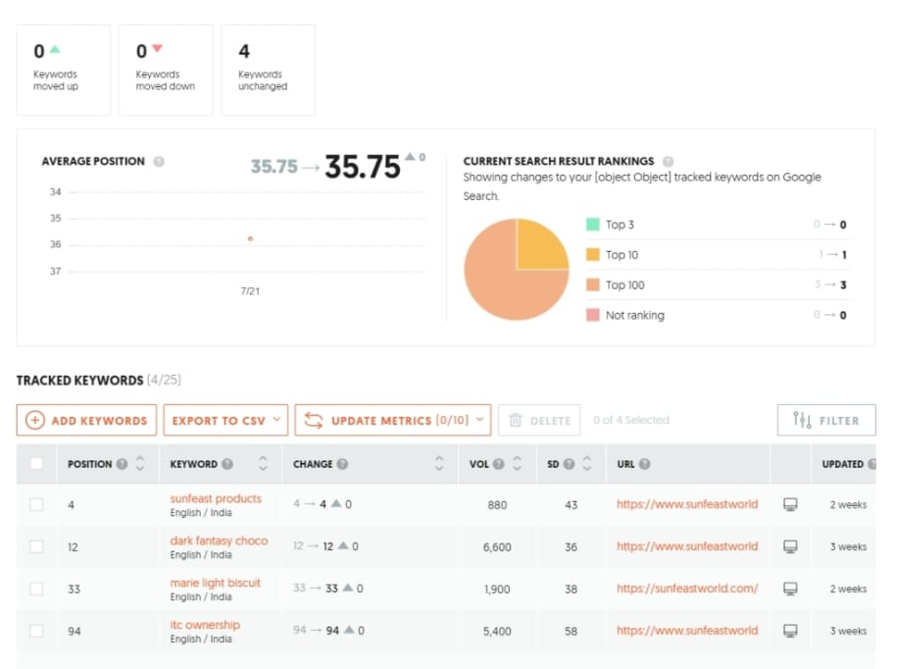

Slide 14
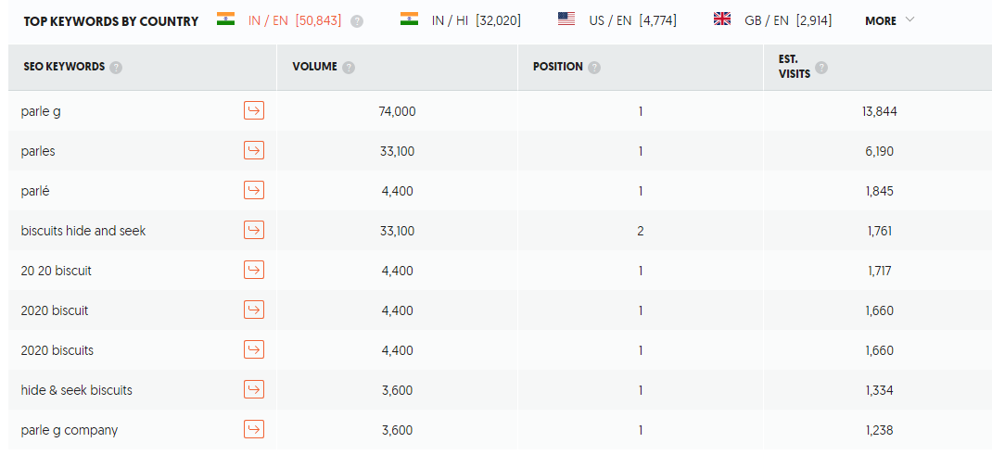
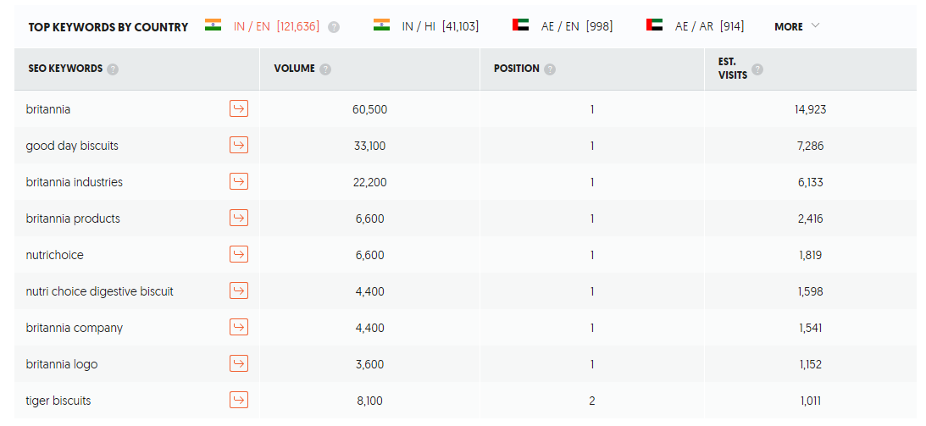

COMPETITOR KEYWORDS ANALYSIS:
PARLE
2. BRITANNIA
3. UNIBIC

Slide 15
SUNFEAST KEYWORDS :
No | No | No | No | No | No | No | Est. Visits | Ranking Url
1 | choco fills | 12100 | â‚¹3.28 | 98 | 40 | 59 | 0 | http://sunfeastworld.com/chocofil-darkfantacyl.html
2 | dark fantasy choco fills | 6600 | â‚¹5.74 | 96 | 36 | 12 | 14 | http://sunfeastworld.com/choco-fills.html
3 | sunfeast mango smoothie | 6600 | â‚¹11.48 | 90 | 39 | 38 | 9 | http://sunfeastworld.com/contactus.html
4 | milk biscuits | 6600 | â‚¹10.25 | 96 | 35 | 69 | 0 | http://sunfeastworld.com/sunfeast-milky.html
5 | mom's magic | 6600 | â‚¹7.79 | 50 | 55 | 40 | 0 | http://sunfeastworld.com/moms_magic.html
6 | momsmagic | 6600 | â‚¹13.12 | 78 | 42 | 92 | 0 | http://sunfeastworld.com/moms_magic.html
7 | moms magic | 6600 | â‚¹7.79 | 50 | 52 | 41 | 0 | http://sunfeastworld.com/moms_magic.html
8 | nice biscuits | 5400 | â‚¹9.43 | 84 | 51 | 36 | 19 | http://sunfeastworld.com/sunfeast-nice.html
9 | itc ownership | 5400 | â‚¹0 | 1 | 58 | 94 | 0 | http://sunfeastworld.com/aboutitc.html
10 | dark fantasy chocolate | 5400 | â‚¹6.56 | 90 | 47 | 54 | 0 | http://sunfeastworld.com/sunfeast-dark-fantasy-choclate.html
11 | mom's magic biscuit | 5400 | â‚¹6.97 | 96 | 35 | 69 | 0 | http://sunfeastworld.com/moms_magic.html
12 | mom's magic biscuits | 5400 | â‚¹6.97 | 96 | 32 | 66 | 0 | http://sunfeastworld.com/moms_magic.html
13 | moms magic biscuits | 5400 | â‚¹6.97 | 96 | 35 | 60 | 0 | http://sunfeastworld.com/moms_magic.html
14 | nice biscuit | 5400 | â‚¹9.43 | 84 | 45 | 53 | 0 | http://sunfeastworld.com/sunfeast-nice.html
15 | salt biscuits | 4400 | â‚¹8.61 | 89 | 44 | 82 | 0 | http://sunfeastworld.com/sunfeast-sweet-n-salt.html
16 | singer competition | 3600 | â‚¹3.69 | 10 | 44 | 55 | 0 | http://sunfeastworld.com/about_delishus_star_singer.html
17 | sunfeast dark fantasy | 2900 | â‚¹6.97 | 93 | 53 | 25 | 3 | http://sunfeastworld.com/chocofil-darkfantacyl.html
18 | dark fantasy sunfeast | 2900 | â‚¹5.33 | 91 | 49 | 22 | 3 | http://sunfeastworld.com/chocofil-darkfantacyl.html
19 | glucose biscuits | 2900 | â‚¹6.97 | 73 | 39 | 36 | 0 | http://sunfeastworld.com/sunfeast-glucose.html
20 | glucose biscuit | 2900 | â‚¹6.97 | 73 | 45 | 77 | 0 | http://sunfeastworld.com/sunfeast-glucose.html

Slide 16
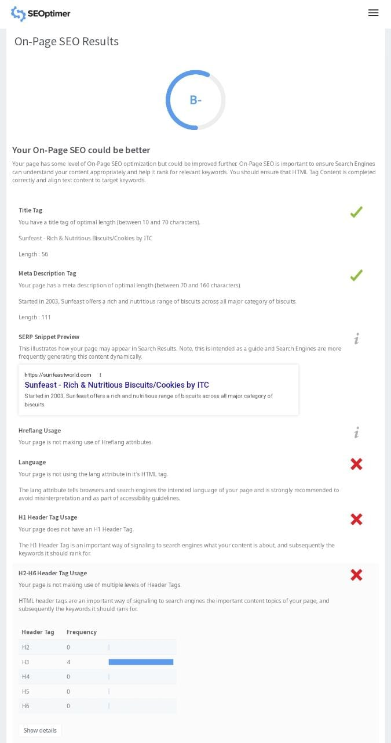
ON PAGE OPTIMIZATION:
META TITLES :
- Sunfeast : delicious, nutritious biscuits and cookies.
- Sunfeast : delicious, nutritious treats for every occasion.
META DESCRIPTIONS :
- Experience the great combination of taste and health with sunfeast biscuits and cookies. Discover our wide range of biscuits and cookies.
- Looking for healthy and tasty biscuits? Sunfeast biscuits are the best choice then. Explore our website to know about biscuits and flavours that are available.

Slide 17
PROCESS OF CONDUCTING KEYWORD RESEARCH :
1. Understand your goals: Begin by defining the purpose of your keyword research. Determine whether you want to Increase your website’s traffic or the other things.
2. Asses initial ideas: Start by brainstorming a list of keywords relevant to your business. Think about what keys your target audience might use when searching for information related to your industry.
3. Use keyword research tools : Utilize keyword research tools such as Google Keyword Planner, SEMrush, or Moz Keyword Explorer. These tools provide valuable insights into search volume, competition, and related keywords.
4. Analyze search intent: Consider the intent behind each keyword. Are users searching with the intent to make a purchase? Understanding search intent helps you align your content with user expectations.
5. Assess competition: Evaluate the competitiveness of each keyword. Look for keywords with a good balance of search volume and manageable competition.
6. Refine your keyword list: Decrease down your keyword list by selecting the most relevant and promising keywords. Focus on those with a good search volume and relatively lower competition.
7. Consider user relevance: Ensure that the selected keywords align with your target audience's interests, needs, and search preferences. Think about how users would search for your content or offerings and choose keywords accordingly.
8. Track and iterate: Regularly monitor the performance of your chosen keywords using tools like Google Analytics.

Slide 18
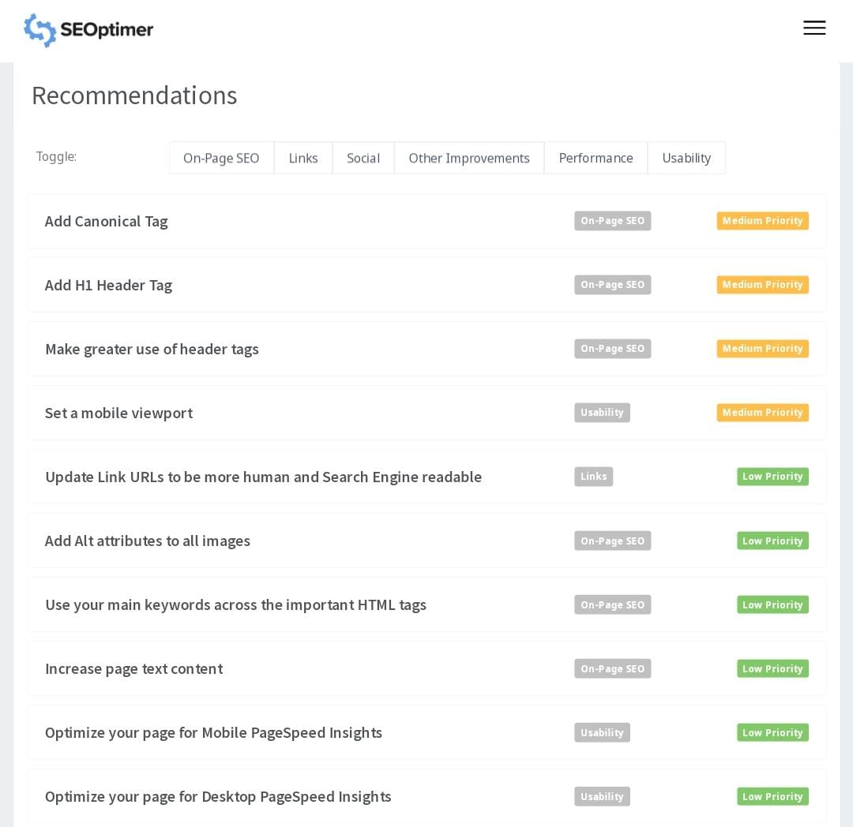
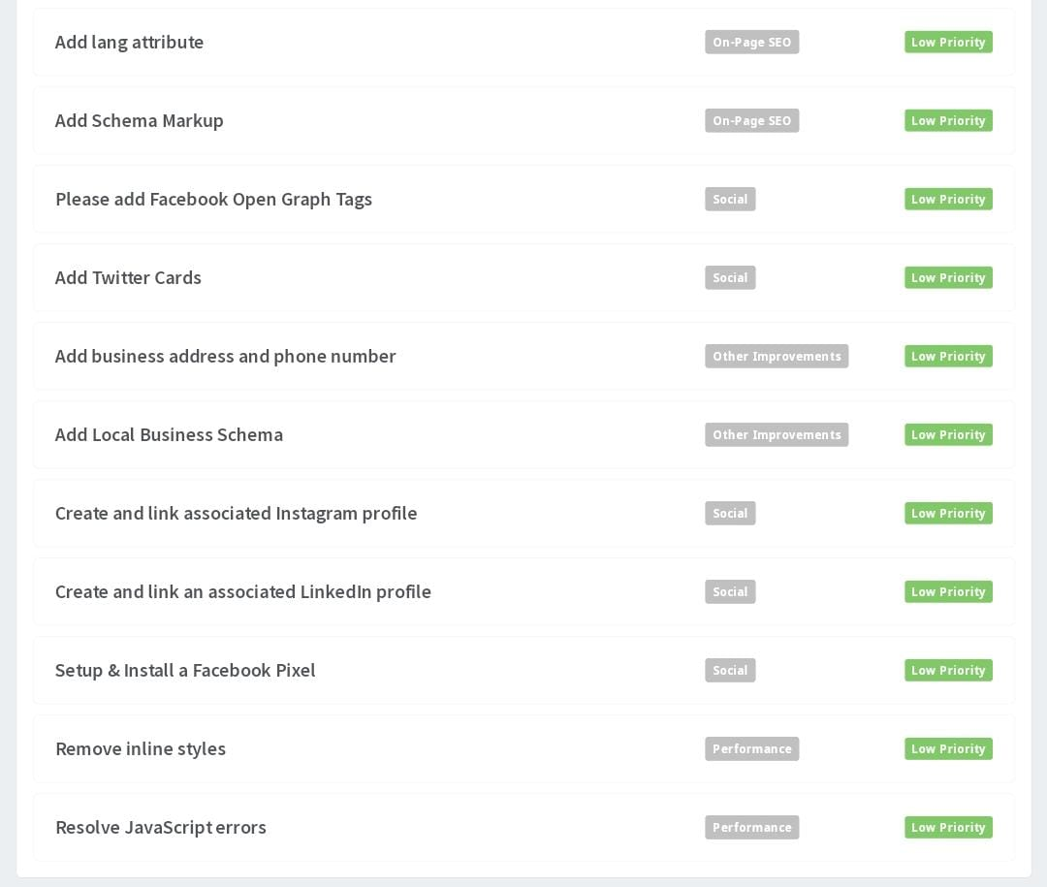

Slide 19
CHALLENGES FACED DURING KEYWORD RESEARCH AND ANALYSIS:
1.Limited data accuracy: Keyword research tools provide estimates and data based on historical trends. It's essential to consider this potential limitation when conducting keyword analysis.
2. Highly competitive keywords: Some keywords may have high search volume but also intense competition. Ranking for such keywords can be challenging, especially if your website or content is relatively new.
3. Shifting search trends: Search trends and user behavior change over . Staying up-to-date with the latest trends and adjusting your keyword strategy accordingly is crucial.
4. Lack of user intent understanding: Merely identifying keywords without considering user intent can lead to suboptimal results. It's important to understand the intent behind a keyword search to provide the most relevant content and capture the right audience.
5. Multilingual keyword research: If you are targeting a multilingual or international audience, conducting keyword research in multiple languages can pose an additional challenge. Language differences, cultural differences, and varying search behaviors need to be considered for effective keyword analysis.

Slide 20
KEY INSIGHTS:
1.Increased organic traffic: By targeting relevant keywords with a good search volume and low competition, you can improve your website's visibility in search engine results.
2. Improved search engine rankings: This can lead to improved visibility, credibility, and more organic traffic.
3. Targeted content creation: Keyword research helps identify the topics and questions that your target audience is searching for. By incorporating these keywords into your content strategy, you can create valuable, relevant content that meets the needs of your audience.
4. Enhanced user experience: Understanding user search intent through keyword research allows you to align your content with what users are looking for. This improves the overall user experience on your website, leading to increased engagement, longer visit durations, and lower bounce rates.
5. Competitive advantage: By focusing on these untapped keywords, you can gain a competitive advantage and attract targeted traffic that your competitors are missing out on.

Slide 21
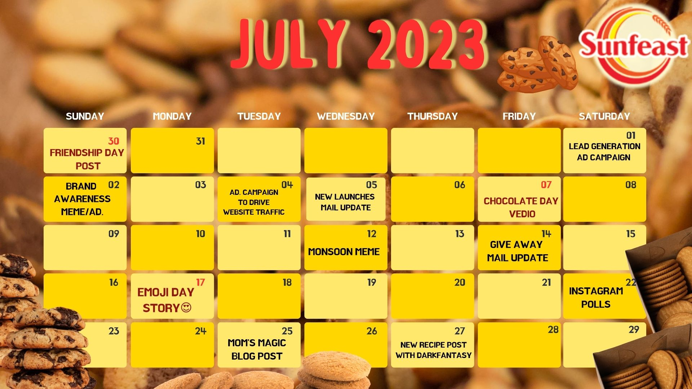
Part 3: Content Ideas and Marketing Strategies
Content Idea Generation & Strategy:
CONTENT CALENDER
FOR THE MONTH JULY:

Slide 22
STRATEGY, AIM, IDEA BEHIND THE CONTENT:
BLOG POST :
Date of publish: 25/7/2023
Topic : Indulge in the magic.
AIM : to provide information and entertain target audience. It will aim to educate , engage and inspire the audience.
STRATEGY : The blog post should be optimised for search engines to attract organic traffic to the website.
IDEA : The idea is generally arrives because of industry trends and customers urge to know more about the product.
2. REEL/ VIDEO POST :
Date of publish : 7/7/2023
Topic : Chocolate day
AIM : The aim of video post is to create a visually appealing and engaging video to attract more customers .
STRATEGY : The strategy behind a reel post would be popularity and as it reaches more audience.
IDEA : It involves showing a product, giving information / demonstration and many.

Slide 23
3. CREATIVE / MEME :
Date of publish : 12/7/2023
Topic : monsoon meme.
AIM : Memes in content marketing creates humour, relatable and makes more people reach it.
STRATEGY : It involves understanding the audience preferences, interests and their online behaviour.
IDEA : To convey the brands message in a creative / funny way.
4. INSTAGRAM STORIES :
Date of publish : 17/7/2023, 22/7/2023
Topic : Emoji day , IG stories.
AIM : To gain insights, to be interactive.
STRATEGY : To make people be interactive with the brands and to make active participation by followers.
IDEA : To capture attention of followers and to engage them.

Slide 24
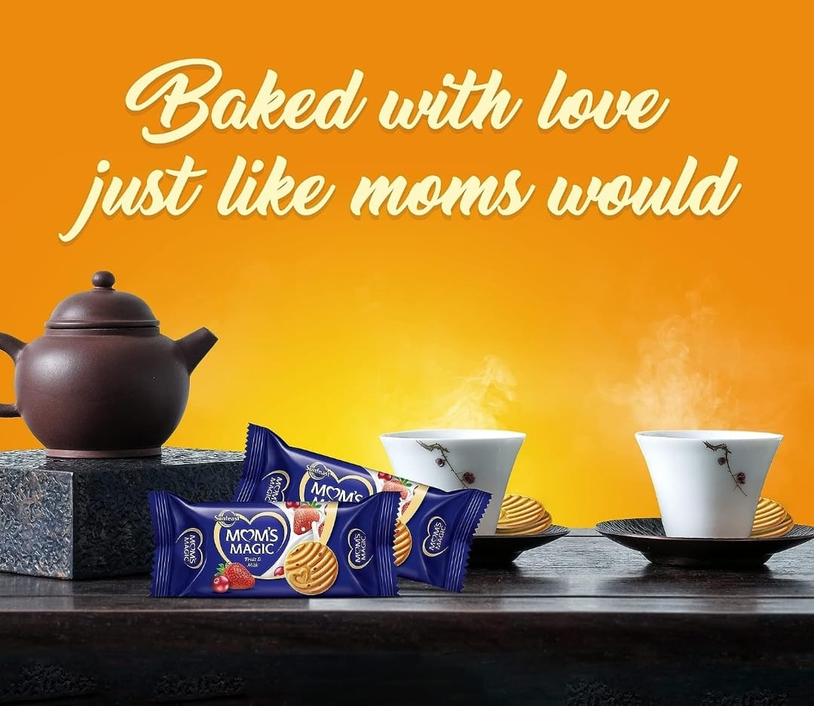
Part 4: Content Creation and Curation
Post Creation:
FORMAT 1 : BLOG POST
Title : INDULGE IN THE MAGIC Unveiling the Delight of Sunfeast Mom's Magic Biscuits.
Brand : Sunfeast Mom’s Magic.
Company : ITC .
There's nothing quite like the nostalgic taste of a delicious biscuit, especially
when it's made with love and care. Sunfeast Mom's Magic Biscuits are a perfect
example of just that, providing a delightfully tasty experience that will takes you
back to your childhood. These biscuits are the perfect indulgence, with a crunchy
texture and a rich buttery flavor that is hard to resist your cravings.
In this post, we're going to reveal more and more delights of Sunfeast Mom's Magic Biscuits. From the ingredients that make them so special, to the process they are made and the different varieties available in the brand. get ready to indulge in the magic of your love for biscuits.

Slide 25

When it comes to indulging in the magic of biscuits Sunfeast Mom's Magic Biscuits are a true pleasure for the senses. These delicious treats are specially crafted to bring a feel of warmth and nostalgia, which reminds you of homemade cookies baked with love by a moms.
Sunfeast, a well known brand in the world of biscuits, has perfectly created
a range of Mom's Magic Biscuits that wakes up your taste buds with their
unique flavors and textures. With every bite, you can experience the perfect
balance of sweetness and a goodness of butter that melts in your mouth.
One of the greatest features of Sunfeast Mom's Magic Biscuits is their
use of real ingredients. The brand takes pride in using only the finest quality
Ingredients, ensuring that each biscuit is filled with authentic flavors.
From rich chocolate chips to crunchy almonds, every ingredient is carefully selected to create a delightful snacking experience.
The attention to details and richness extends beyond just taste. These Biscuits are also beautifully designed, featuring great patterns and simple shapes. Whether it's the classic round biscuits or the adorable heart-shaped ones, each biscuit is a work of art, adding a touch of visual appeal to your snacking experience.

Slide 26

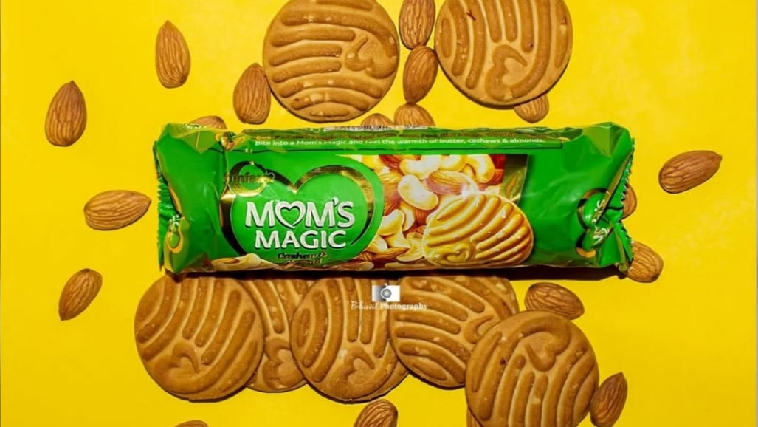
The secret behind the magical taste of
Sunfeast Mom's Magic biscuits lies in their carefully designed recipe and the finest ingredients used. Every bite of these delectable biscuits is a shows the brand's commitment to delivering an unforgettable sensory experience. Sunfeast Mom's Magic biscuits are baked to perfection, ensuring a delightful crunch with every bite. The combination of premium ingredients such as wheat flour, sugar, butter, and a hint of magical flavors creates a symphony of taste that lingers on your palate.
Sunfeast Mom's Magic biscuits offer a delightful range of flavors that are sure to tantalize your taste buds. From the classic butter flavor to the rich and indulgent chocolate, there is something to satisfy every craving. For those who prefer a hint of sweetness, the honey and almond flavor is a perfect choice. The combination of the smooth honey and crunchy almond creates a delectable treat that is both comforting and satisfying.

Slide 27
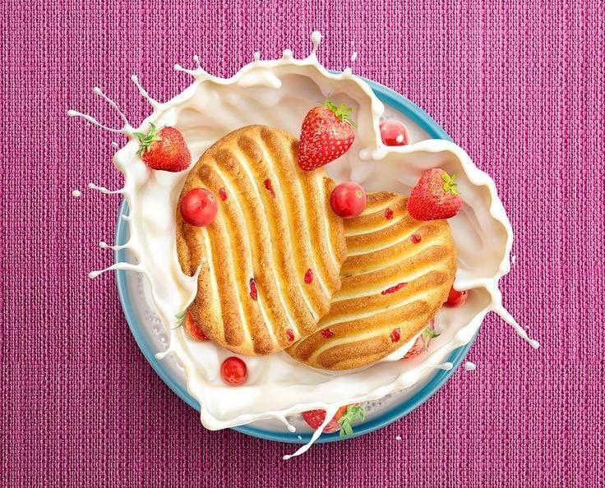
Sunfeast Mom's Magic biscuits not only offer a delightful taste but also come with several health benefits. These biscuits are made with carefully selected ingredients that are known to promote good health. One of the key health benefits of Mom's Magic biscuits is their high fiber content.
Fiber plays a crucial role in maintaining a healthy digestive system and preventing constipation. By incorporating these biscuits into your daily routine, you can ensure a good intake of dietary fiber, which is essential for overall well-being.Additionally, Mom's Magic biscuits are made with the goodness of whole grains. Whole grains are rich in nutrients and antioxidants, making them an excellent choice for a healthy snack. They provide sustained energy and help in maintaining steady blood sugar levels, keeping you fueled throughout the day.
We hope you enjoyed our blog post that delved into the delight world of Sunfeast
Mom's Magic Biscuits. These biscuits are not just a treat for your taste buds, but a
magical experience that evokes feelings of nostalgia and warmth. From their rich and
flavorful ingredients to their charming heart-shaped design, Sunfeast Mom's Magic
Biscuits are truly a delight to indulge in. We encourage you to try them for yourself
and experience the magic firsthand. Treat yourself to a moment of bliss with Sunfeast
Mom's Magic Biscuitand let them transport you to a world of pure culinary delight.

Slide 28
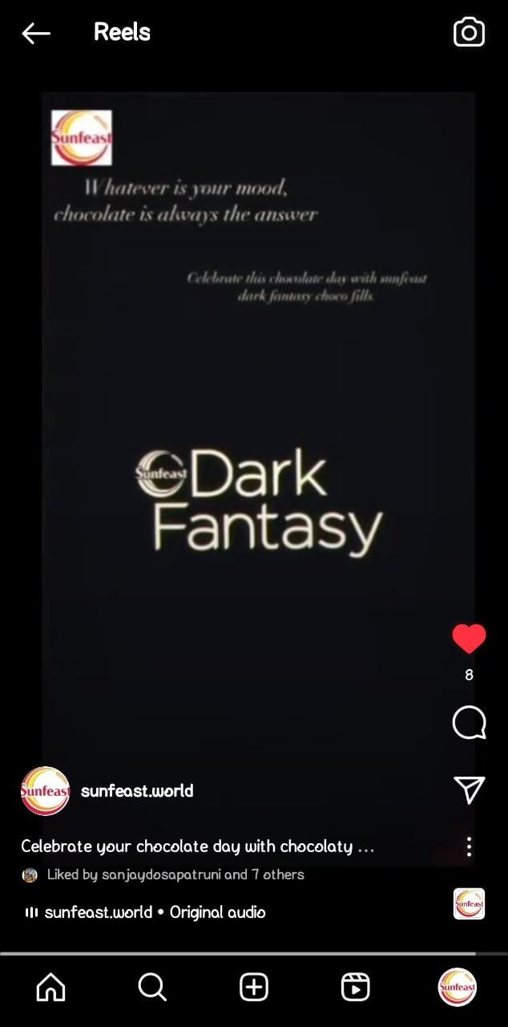
FORMAT 2 : REEL/ VIDEO POST
Title : Chocolate Day Video.
Caption : Celebrate your chocolate day with chocolaty sunfeast dark fantasy
choco fills.
Hashtags : #chocolateday , #chocofills , #darkfantasy .
Posted date : 7/7/2023
Link :
https://www.instagram.com/reel/CvEeIG0BpRX/?igshid=MzRlODBiNWFlZA==

Slide 29
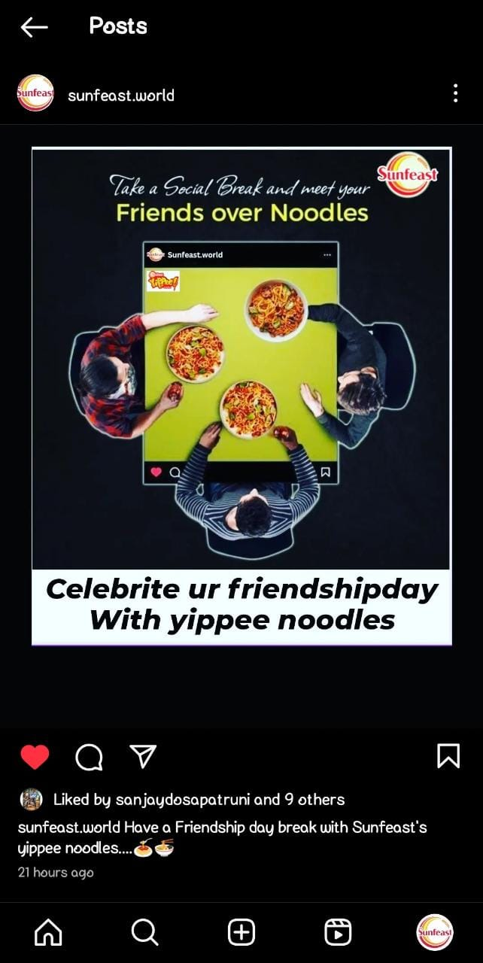
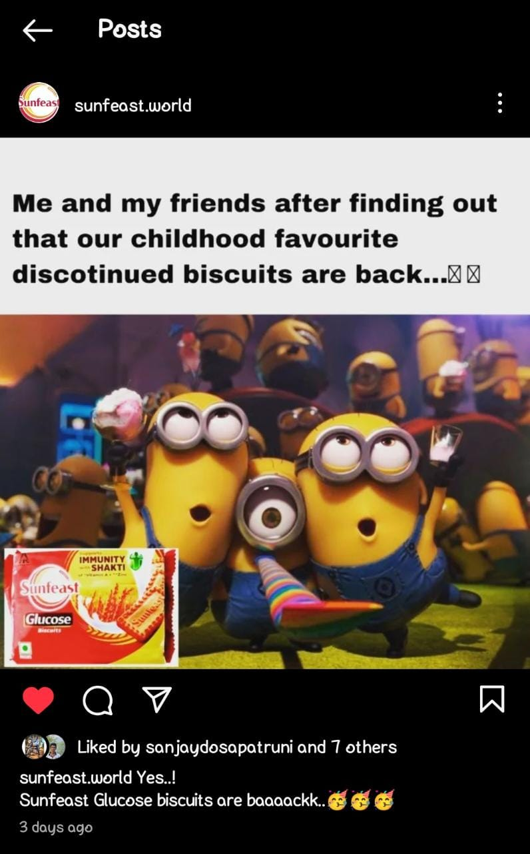
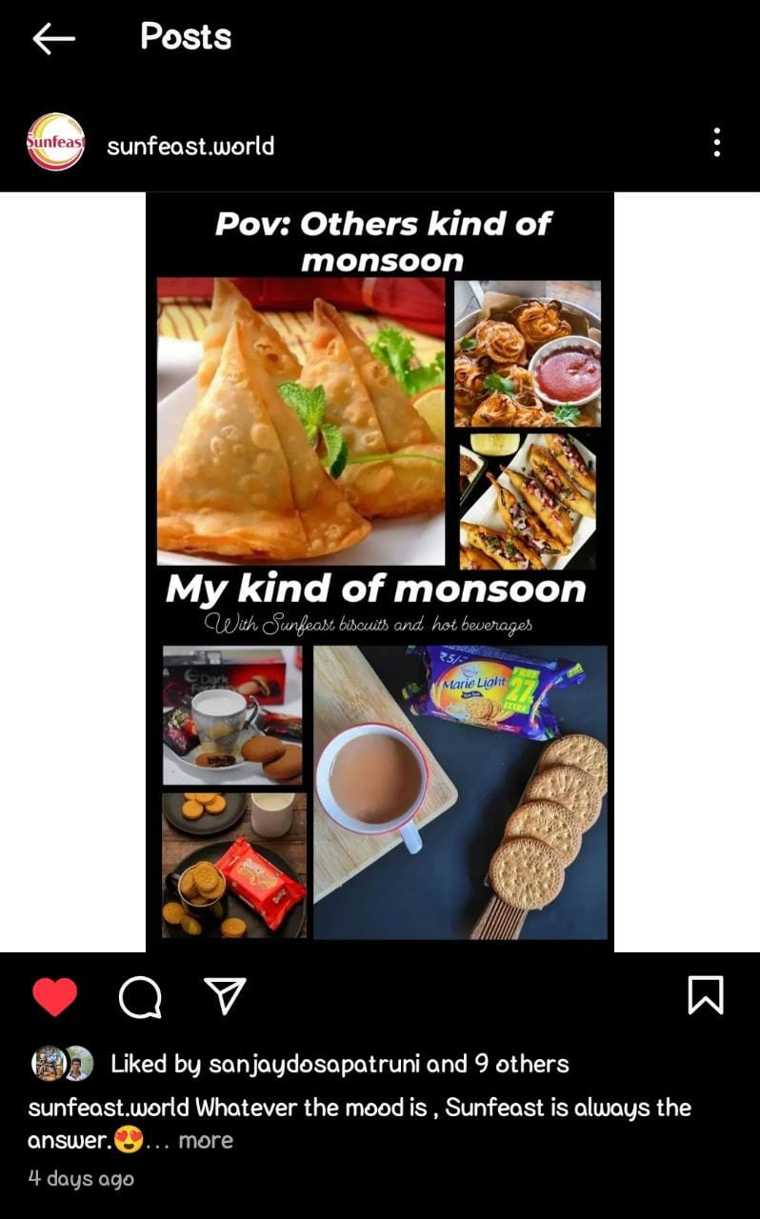
FORMAT 3 : CREATIVES / MEMES
AIM : To make the audience know about relaunch of discontinued sunfeast biscuits.
LINK : https://www.instagram.com/p/CvCBrwyBF4B/?igshid=MzRlODBiNWFlZA==
AIM : To engage and entertain the audience.
LINK :
https://www.instagram.com/p/CvAXVffPIVk/?igshid=MzRlODBiNWFlZA==
AIM : To engage the audience.
LINK : https://www.instagram.com/p/CvH6oMBh1me/?igshid=MzRlODBiNWFlZA==

Slide 30
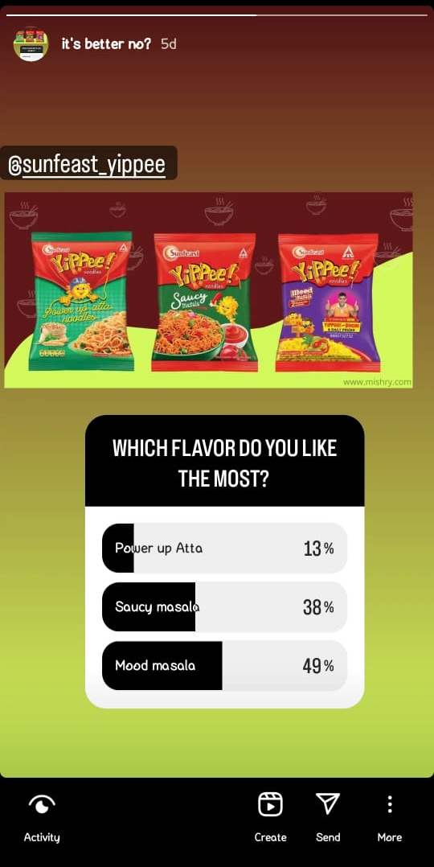
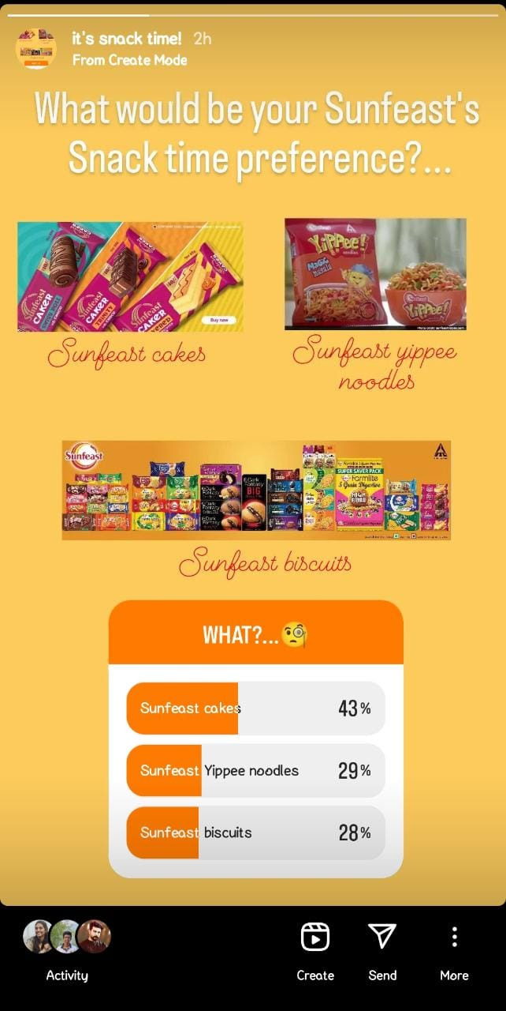
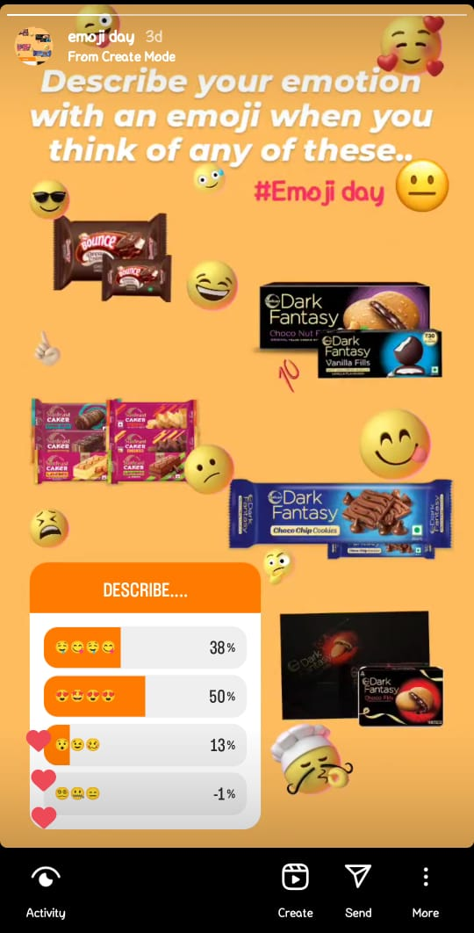
INSTAGRAM STORIES :
CONCEPT : EMOJI DAY POLL
HIGHLIGHTS LINK : https://www.instagram.com/s/aGlnaGxpZ2h0OjE3ODQ3MDYyMDY0MDIyMTEz?story_media_id=3151617102577124470_60690012303&igshid=MzRlODBiNWFlZA==
CONCEPT : FAVOURITE NOODLES POLL
HIGHLIGHTS LINK : https://www.instagram.com/s/aGlnaGxpZ2h0OjE3ODQ3MDYyMDY0MDIyMTEz?story_media_id=3151617102577124470_60690012303&igshid=MzRlODBiNWFlZA==
CONCEPT : SNACK TIME PREFERENCE POLL
HIGLIIGHTS LINK : https://www.instagram.com/s/aGlnaGxpZ2h0OjE3OTgxNzQ3Mjg1MTI3Njk3?story_media_id=3154824641965737136_60690012303&igshid=MzRlODBiNWFlZA==

Slide 31
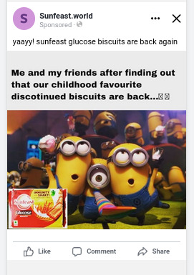
SOCIAL MEDIA CAMPAIGNS :
1. BRAND AWARENESS :
This ad campaign is made to make the customers aware of the sunfeast discontinued glucose biscuits are back again into the market .
AD GOALS : To make our customers know / to make them aware of the biscuits that are discontinued long back are back again into the market.
AUDIENCE TARGETING : The people has nostalgic feel with these biscuits are the main target for this ad campaign.

Slide 32
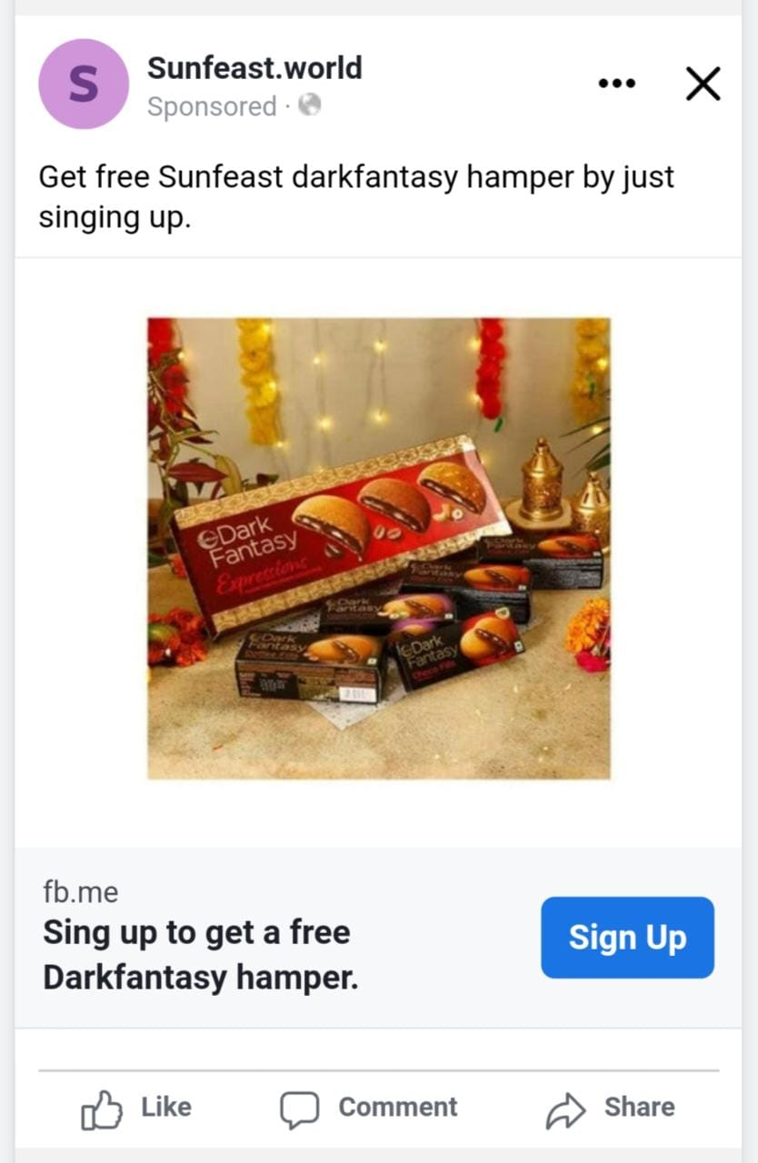
2. LEAD GENERATION:
This ad campaign is made to generate more leads by
making them signup for a free gift hamper.
AD GOALS : The main goal of this ad campaign is to generate
more leads.
AUDIENCE TARGETING : Everyone.

Slide 33
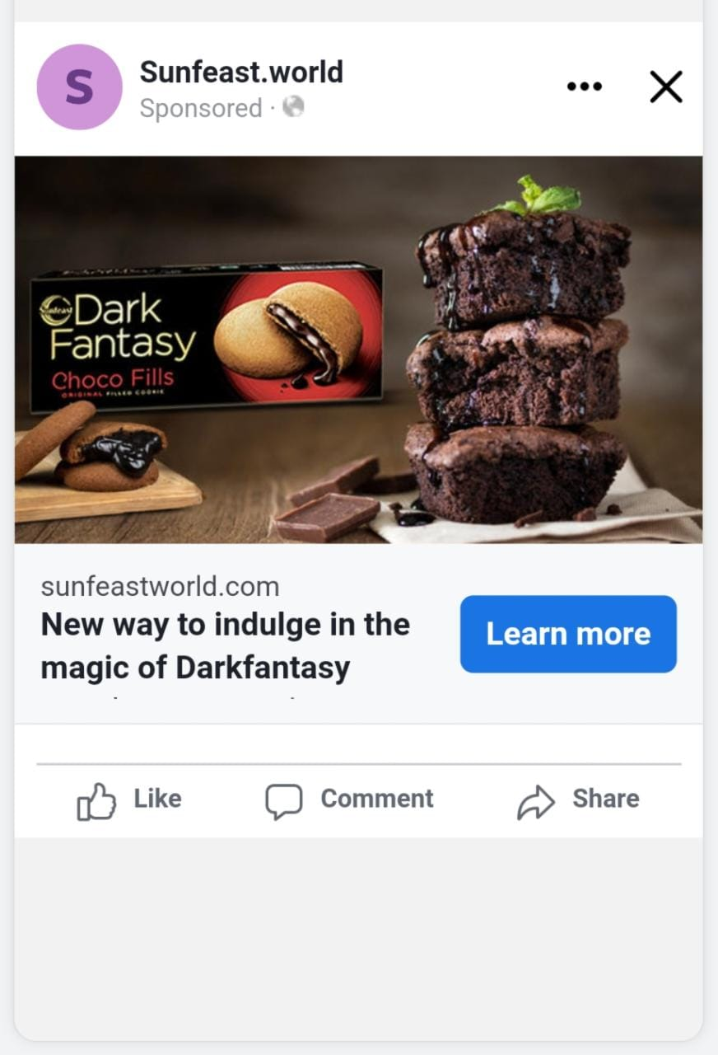
3. DRIVING WEBSITE TRAFFIC :
This ad campaign is made to drive more website
traffic by making them curious about the new
recipe that is made using dark fantasy.
AD GOALS : To drive website traffic with this
ad campaign.
AUDIENCE TARGETING : People who try new
receipes with biscuits.

Slide 34
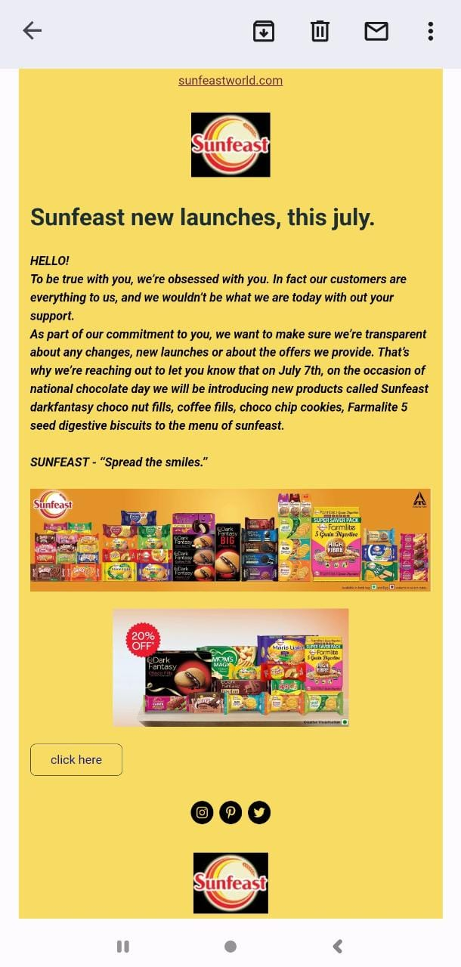
Email Ad Campaigns:
BRAND AWARENESS :
In this mail we have done a brand awareness
Informing the audience about the new launches
On 7th of july.

Slide 35
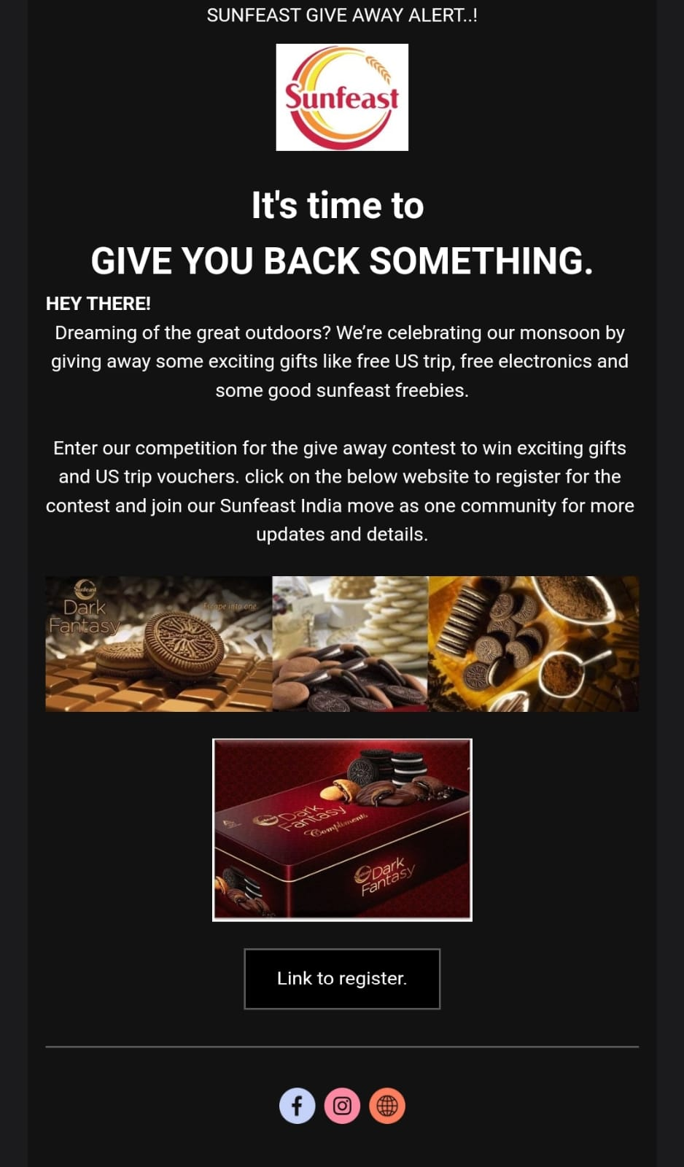
LEAD GENERATION :
In this mail we have provided a link to register for the
Contest of give away that we are conducting offering a
Free US trip and some freebies for the winners.

Slide 36
CONTENT CREATION AND CREATION PROCESS :
Define Goals and Objectives: Start by clearly defining the goals and objectives of your content creation. Determine what you want to achieve, whether it's increasing brand awareness, driving website traffic, generating leads, or fostering engagement. Having clear objectives will provide guidance throughout the process.
Identify Target Audience: Understand who your target audience is and what their interests, preferences, and needs are. Conduct market research to gather insights.
Content Ideation: Brainstorm ideas that align with your goals and target audience. Consider creating a content calendar to plan and organize your content in advance. Generate ideas based on trends, industry news, customer pain points, and popular topics.
Content Creation: Once you have solid ideas, it's time to create the content. This involves writing blog posts, designing visuals, or developing any other relevant formats. Pay attention to quality and ensure that the content is well-researched, informative, engaging, and aligns with your brand voice and values.
Content Optimization: Optimize your content for search engines and social media platforms.
6. Publish and Promote: Once the content is finalized, publish it on your website, blog, or social media channels. Spread the word through promotional efforts such as email marketing, social media posts, and paid advertising. Consistently monitor the performance of your content.

Slide 37
CHALLENGES FACED AND LESSONS LEARNED :
Challenges Faced:
Developing Unique and Engaging Content: One of the challenges in content creation for a brand is constantly coming up with fresh, unique, and captivating ideas.
Understanding the Target Audience: Creating content that resonates with the target audience requires a deep understanding of their preferences, interests, and behaviors.
Keeping Up with Trends and Changes: The digital landscape is dynamic, with trends and algorithms constantly evolving. Staying up-to-date with industry trends and adapting to these changes and finding ways to incorporate them into the brand's content strategy is crucial for relevance and engagement.

Slide 38
Lessons Learned:
Consistency is Key: Consistency in content creation helps to establish brand recognition and build a loyal audience. Maintaining a consistent brand voice, visual identity, and posting schedule creates a cohesive brand experience for the audience.
Quality Over Quantity: While it's important to consistently create content, focusing on quality should take precedence over quantity. Well-produced and thoughtful content tends to have a more significant impact and can lead to higher engagement and brand loyalty.
Building Relationships and Collaborations: Collaboration with influencers, partners, or customers can provide fresh perspectives and expand the reach of the brand's content. Collaborations help tap into new audiences, bring in diverse ideas, and create engaging content.

